Slide 1
Modeling data in organization
Data modeling is an important tool .Because the purpose of data modeling is to document rules and policies of an organization that manage data
Identifying and documenting business rules are keys to checking your data model for accuracy and completeness.

Slide 2
Modeling data in organization
The entity-relationship notation is used to document rules and policies of an organization.
It is important to recognize that not all business rules can be represented in the ERD.
Some business rules must be implemented by programming.

Slide 3
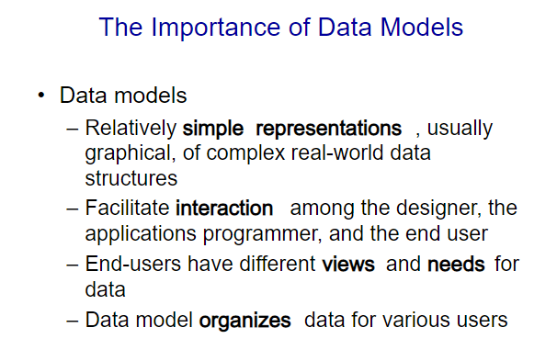

Slide 4
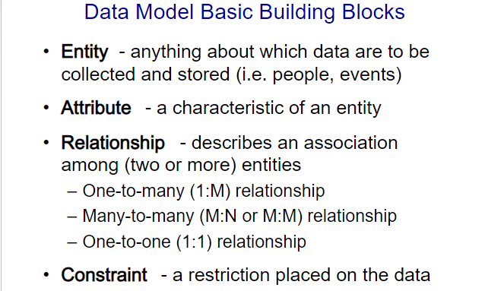

Slide 5
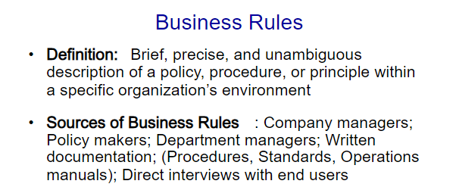

Slide 6
Business rules
Business rules describe the business policies that apply to the data stored on a company's databases. In other words, business rules reflect how a business perceives its use of data
Business rules and policies govern creating, updating, and removing data in an information processing and storage system; thus they must be described along with the data to which they are related
For example, the policy “every student in the university must have a faculty adviser” forces the data in a database about each student to be associated with data about some student adviser.

Slide 7
Business rules
Business rules and policies are not universal; different universities may have different policies for student advising and may include different types of people as students.
Also, the rules and policies of an organization may change over time;
a university may decide that a student does not have to be assigned a faculty adviser until the student chooses a major.

Slide 8
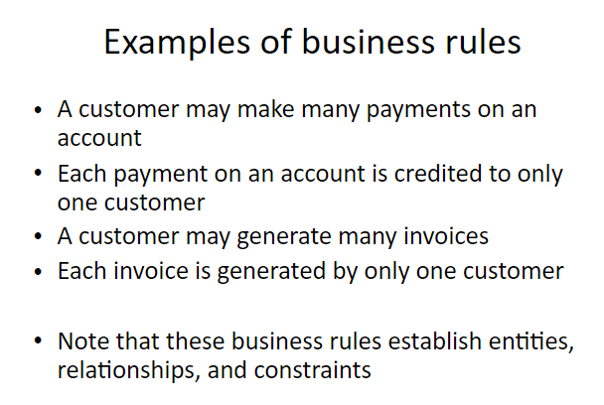

Slide 9
Statement structure of Business Rules
Are statements that define or constrain some aspect of the business
Syntax of business rules:
ENTITY_1 Relationiship_Verb_Phrase number ENTITY_2
ENTITY_2 Relationiship_Verb_Phrase number ENTITY_1
where Relationiship_Verb_Phrase =
Cardinality_adverb + Relationship_Verb
Examples:
ENTITY_1 | May/Must | verb | number | ENTITY_2
STUDENT | may | have | many | ENROLLMENT
CAR | must | be registered to | at least one | OWNER
CUSTOMER | must | be served by | only one | EMPLOYEE
STUDENT | may | be assigned | At most one | PERMIT

Slide 10
Types of business rules
Structural business rules
Procedural business rules

Slide 11
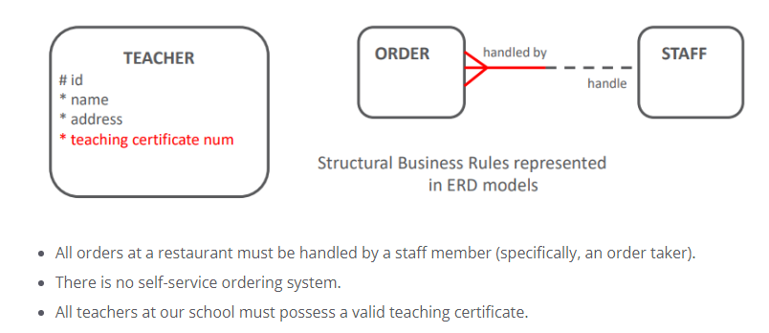
Structural business rules
Structural business rules indicate the types of information to be stored (attributes) and how the information elements interrelate (relationships)
Structural business rules can nearly always be diagrammed in the ERD.

Slide 12
Structural business rules example
Consider Human Resource Department scenario:“Some of our employees are required to attend mandatory training events.
These events take place at one of the company’s existing locations, and the employees travel to the location to take part in the training.”
We can model the relationships between EMPLOYEEs , TRAINING and LOCATIONs in an ERD as this is an example of a Structural Business Rule.

Slide 13
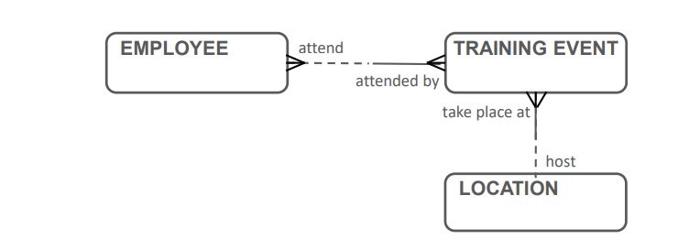
Structural rules example

Slide 14
Procedural rules
Procedural rules deal with the prerequisites, steps, processes, or workflow requirements of a business.
Many procedural business rules are related to time: event A must happen before event B.
Some procedural business rules cannot be diagrammed, but must still be documented so that they can be programmed later

Slide 15
Procedural rules example
Approval for all travel requests to a training event must be signed by the employee’s manager before the employee can register for the event.”
We cannot model the second Business rule in an ERD, as it is an example of a workflow related rule.

Slide 16
Procedural rules
These Procedural Rules must be recorded in a separate document that will supplement the ERD.
Different Organizations will have different formats for documenting a Business rule, but are often word processed documents or presentation software slides.

Slide 17
Documenting Rules
In the process of developing a conceptual data model, not all business rules can be modeled.
Some rules such as the two listed below must be implemented by programming the processes that interact with data:
Any employee whose overtime exceeds 10 hours per week must be paid 1.5 times the hourly rate.
Customers whose account balances are 90 days overdue will not be permitted to charge additional orders.

Slide 18
Business rules
Your job as a database analyst is to
Identify and understand those rules that govern data
Represent those rules so that they can be unambiguously understood by information systems developers and users
Implement those rules in database technology

Slide 19
Business rules constraints
Business-rules constraints fall into two categories: field constraints within tables, and relationship constraints between table

Slide 20
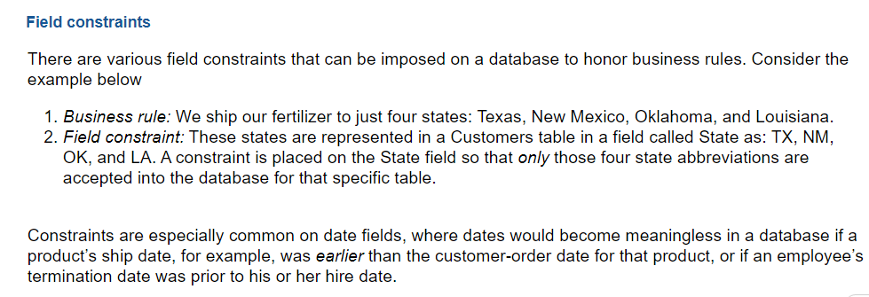
Business rules constraints

Slide 21
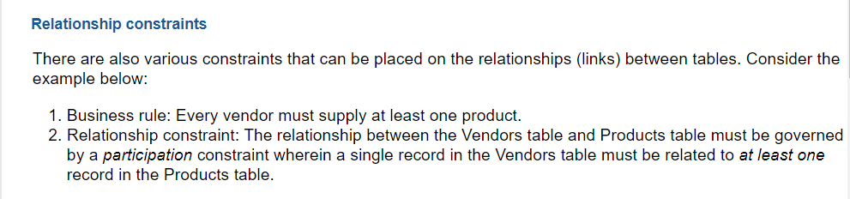
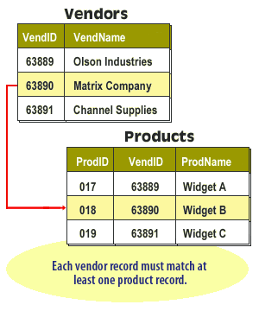
Relationship constraints

Slide 22
Relationship constraint
Relationship constraints (discussed later in this course) dictate that certain entities in a relationship have mandatory status, while others have optional status.
Documentation continues for the designer, who should be creating a list of business rules for the organization as reflected in any constraints (if applicable) placed on the existing database(s).

Slide 23
Scope of business rules
Most organizations have a host of rules and/or policies that fall outside this definition.
For example, the rule “Friday is business casual dress day” may be an important policy statement, but it has no immediate impact on databases.
A student may register for a section of a course only if he or she has successfully completed the prerequisites for that course” is within our scope
because it constrains the transactions that may be processed against the database. In particular, it causes any transaction to be rejected that attempts to register a student who does not have the necessary prerequisites.

Slide 24
Scope of business rules
some business rules cannot be represented in common data modeling notation
those rules that cannot be represented in a variation of an entity-relationship diagram are stated in natural language, and some can be represented in the relational data model,

Slide 25
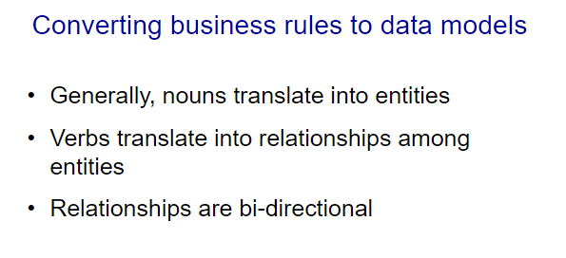

Slide 26
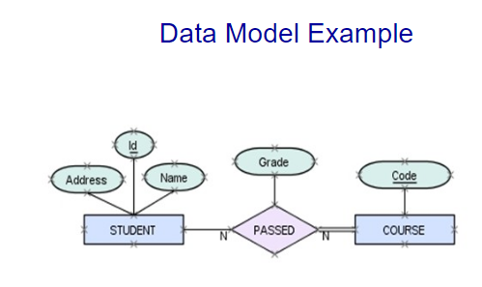

Slide 27
Example of converting business rules to data models

Slide 28
A and B business rules and instructions for creating ERD
A and B is a small company that sells boats. A and B keeps its models in several show rooms across city .At this stage customers cannot view models online so to order they must visit one of the showrooms. A and B has been using excel sheets to track their business activties.How ever this has caused many redundancies and in efficiency
With view to their expanding business and under new management. They decided to investigate the option of database system. You are hired to design a relational database to better track and record their operational data

Slide 29
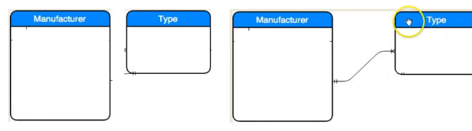
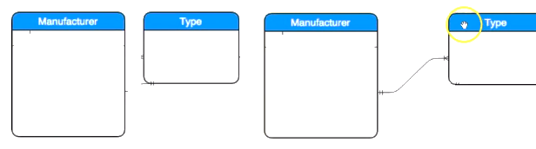
A and B business rules and instructions for creating ERD
A and B can get boats from several different manufacturers. Each manufacturer produced one or more different types of boats. Each and every type is produced by only one manufacturer.

Slide 30
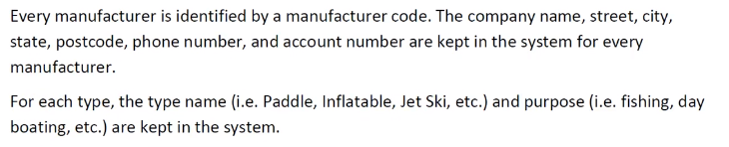
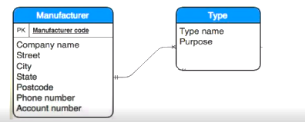
A and B business rules and instructions for creating ERD

Slide 31
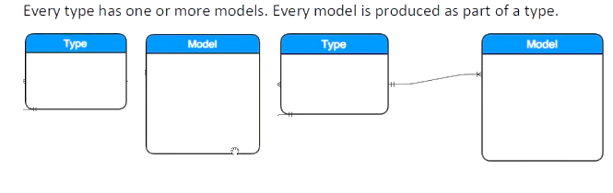
A and B business rules and instructions for creating ERD

Slide 32
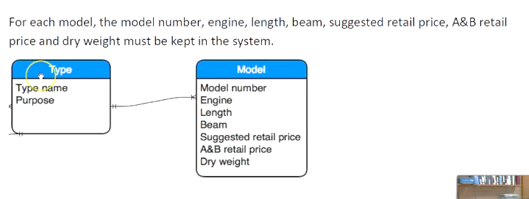
A and B business rules and instructions for creating ERD

Slide 33
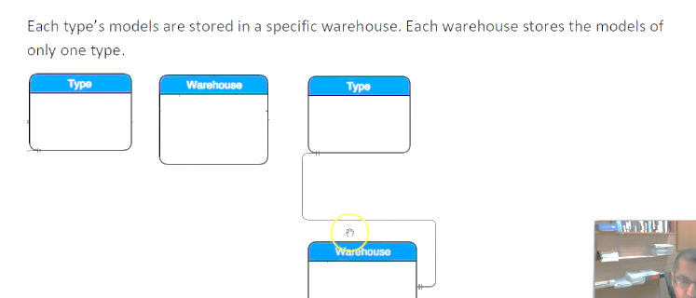
A and B business rules and instructions for creating ERD

Slide 34
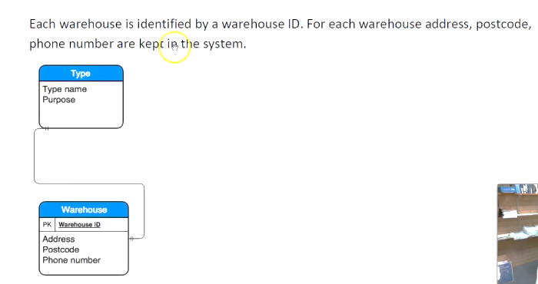
A and B business rules and instructions for creating ERD

Slide 35
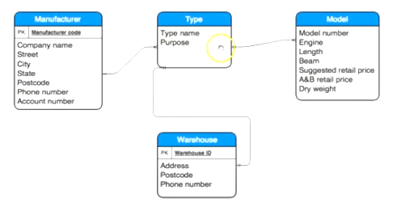

Slide 36
EXAMPLE OF BUSINESS RULES

Slide 37
A SUPPLIER may supply many ITEMs
(by “may supply,” we mean the supplier may not supply any items).
2. Each ITEM is supplied by any number of SUPPLIERs
(by “is supplied,” we mean that the item must be supplied by at least one supplier).
3.Each ITEM must be used in the assembly of at least one PRODUCT and may be used in many products. Conversely, each PRODUCT must use one or more ITEMs.

Slide 38
4. A SUPPLIER may send many SHIPMENTs. However, each shipment must be sent by exactly one SUPPLIER.
5. A CUSTOMER may submit any number of ORDERs. However, each ORDER must be submitted by exactly one CUSTOMER.
Given that a CUSTOMER may not have submitted any ORDERs, some CUSTOMERs must be potential, inactive, or some other customer possibly without any related ORDERs.
6. An ORDER must request one (or more) PRODUCTs. A given PRODUCT may not be requested on any ORDER or may be requested on one or more orders

Slide 39
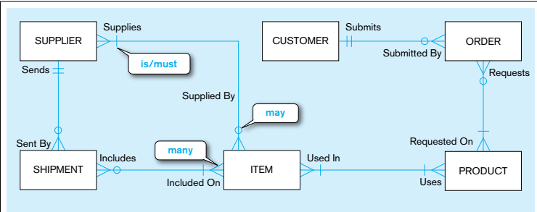

Slide 40
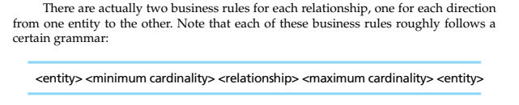
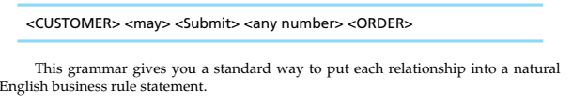
.

Slide 41
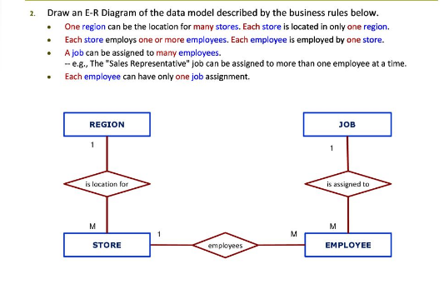

Slide 42
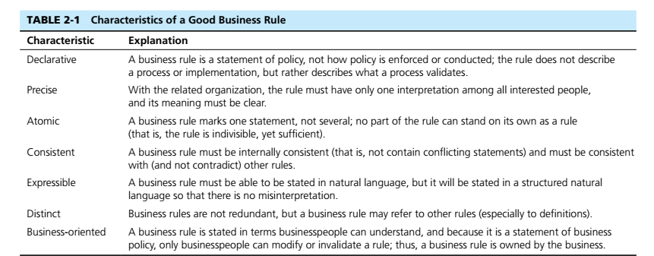
Characteristics of good business rules

